Slide 1
Strings, List & Slicing
Marek Kwasniewski
Automation & Tooling

Slide 2
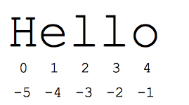

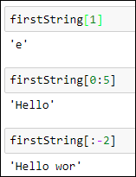
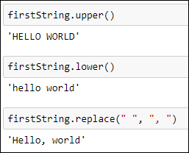
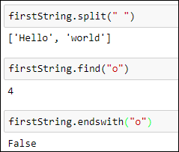
Strings
String – immutable and ordered sequence of characters
Sample Methods:
count
index
capitalize
split
endswith
find
replace
islower
isupper
lower
upper
lstrip
rstrip
strip

Slide 3
Knowledge Check
Create a sentence as a string, count how many spaces are in it.
Sample: sentence = “I love this UBS Python class!”
Replace all the spaces with Underscores
Display the sentence without the first word.
Find the first U in your sentence

Slide 4
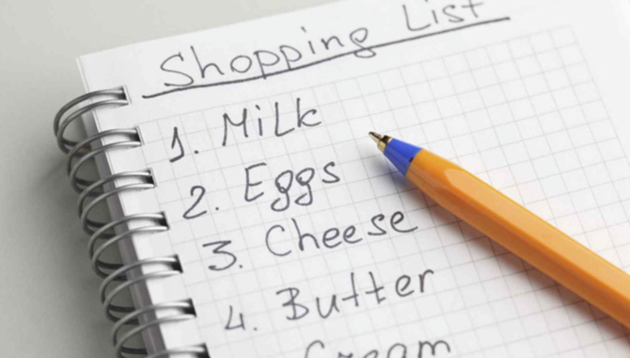

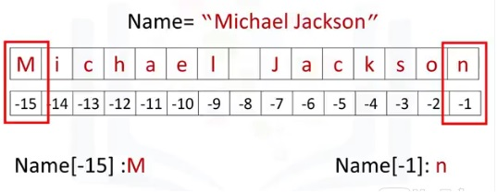
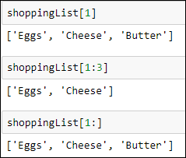
Lists
- ordered and mutable(changeable) collection of items
- allows duplicate members.
Create a list:
Accessing/Slicing items:

Slide 5
Knowledge Check
Open your omelet program
Provide the user a list of ingredients available to add to an omelet
Have the user type into a string the chosen ingredient
Sample Ingredients:
Mushrooms, Onion, Red Pepper, Cheese, Spinach

Slide 6


List Operations
Methods:
index(): returns the position at the first occurrence of the specified value.
append(): appends an element to the end of the list.
count() : Returns the number of elements with the specified value.
extend() : add the elements of a list (or any iterable), to the end of the current list

Slide 7



List Operations
Methods:
insert() : adds an element at the specified position
remove() : Removes the item with the specified value
pop() : Removes the element at the specified position
clear() : Removes all the elements from the list
sort() : Sorts the list

Slide 8
Knowledge Check
Prompt the user to enter a new ingredient to a list
Append your list with the new ingredient
Print the list for a user
Have the user select an item to remove from the list by number
Remove the item
Print the list, sorted alphabetically

